Slide 1

App Store
Fake Review Detection
Hande Gulbagci Dede, PhD

Slide 2
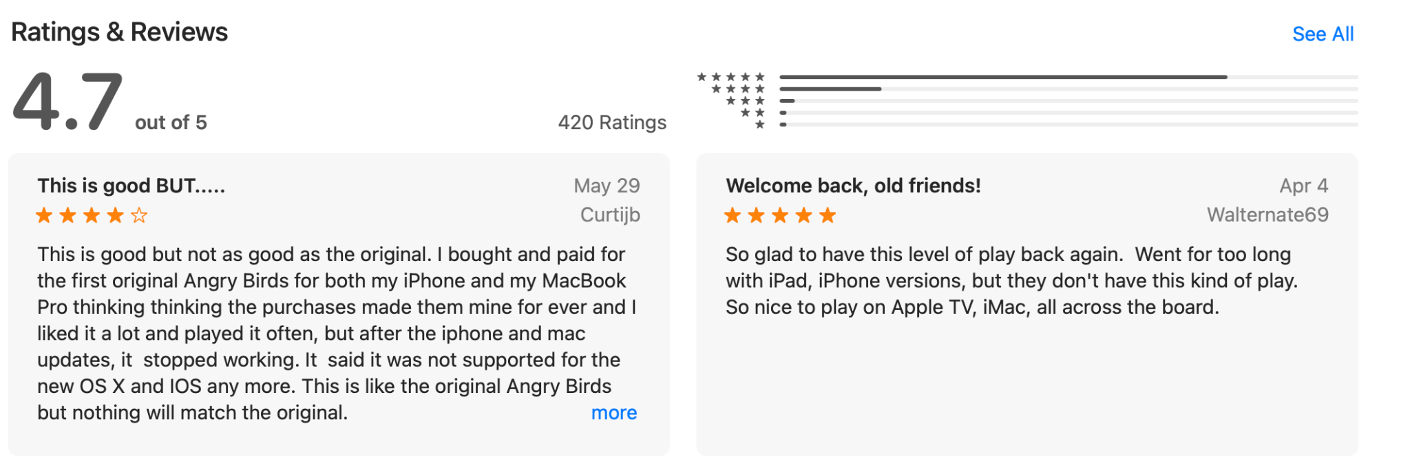
Online Reviews
Online reviews are an important and inevitable aspect of e-commerce.
Similar to online reviews, before downloading an app, users often read through the reviews.
Notes:
Ratings and reviews correlate with sales and download ranks

Slide 3
The Problem
Positive reviews promote the download and sales of applications.
Some app developers mislead users by posting fake and high-rating reviews.
Misguide users into making wrong decisions
Cause economic damage to other application owners
Goal: Build a classifier that can accurately classify the App Store review as genuine and fake
Notes:
Ratings and reviews correlate with sales and download ranks

Slide 4
Data
The Apple App Store reviews dataset is created by Martens and Maalej (2019).
Features Data
Reviews Data
Applications Data
19 features
8696 unique users
5624 unique apps
Review labels as fake and real
31 features
16000 reviews (8000 fake & 8000 real)
10 features related to reviews such as review body, title, posting time
31 features
Meta-data of apps
5563 unique apps
61 apps info is missing

Slide 5
Data Wrangling
Regular Steps
Shape, Data Types, NaNs, Duplicates etc.
Dropped Columns
Columns with just unique value
Identical columns (i.e.contentAdvisoryRating ,trackContentRating )
Non-imputable columns (Advisories columns with 10.7% NaNs)
Columns have same mission (i.e. Genres, GenresId)
Irrelevant data (i.e creator name)
Create New Features
Price ⇨ Paid - Free
Version ⇨ Major version (i.e. 8.7.26 ⇨ 8 )
Datetime Objects ⇨ Year, Month, Day
languageCodesISO2A ⇨ # of languages
supportedDevices ⇨ # of supported devices
Merge DataFrames
All features dataframe
Ready for EDA!

Slide 6






8696 Unique Users
5624 Unique Apps
91.9%
0.1%
8%
66.4%
1.2%
32.4%
No fake reviews
At least 1 fake review
All reviews are fake
No fake reviews
At least 1 fake review
All reviews are fake
Labeling criteria: If an app/user has at least one fake review, this app/user is unreliable.
Notes:
Ratings and reviews correlate with sales and download ranks

Slide 7
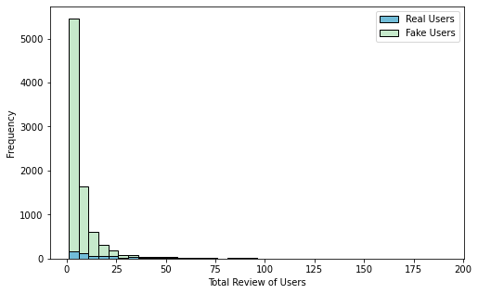
Users’ Total Reviews
Fake users (X̅ = 31.6) have posted more reviews than real users (X̅ = 6.85). This difference is statistically significant (t = -29.3, p < .05).

Slide 8
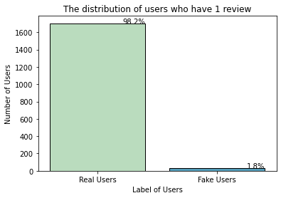
Users’ with Just One Review
1734 users (19.9%) out of total users
Important indicator of not being fake

Slide 9
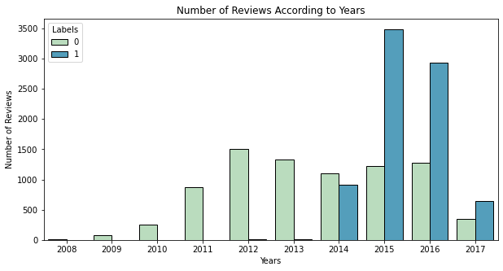
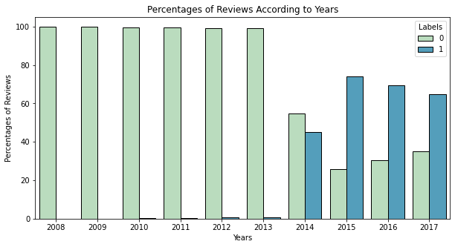
Distribution of Reviews According to Years

Slide 10
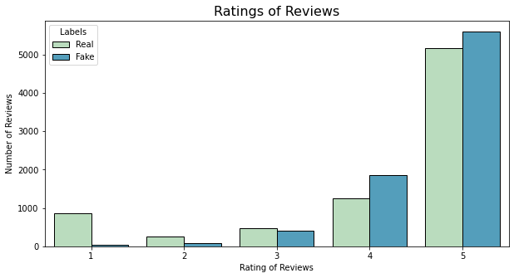
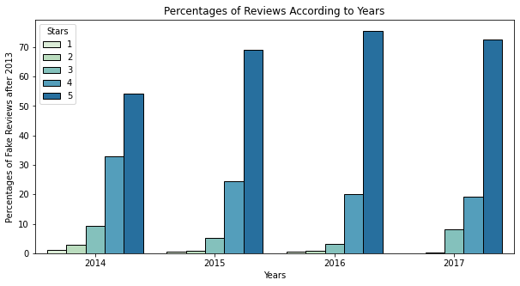
Rating of Reviews
Unreliable apps can get fake reviews for two reasons:
Promote their application, or
Sabotage rival applications.

Slide 11
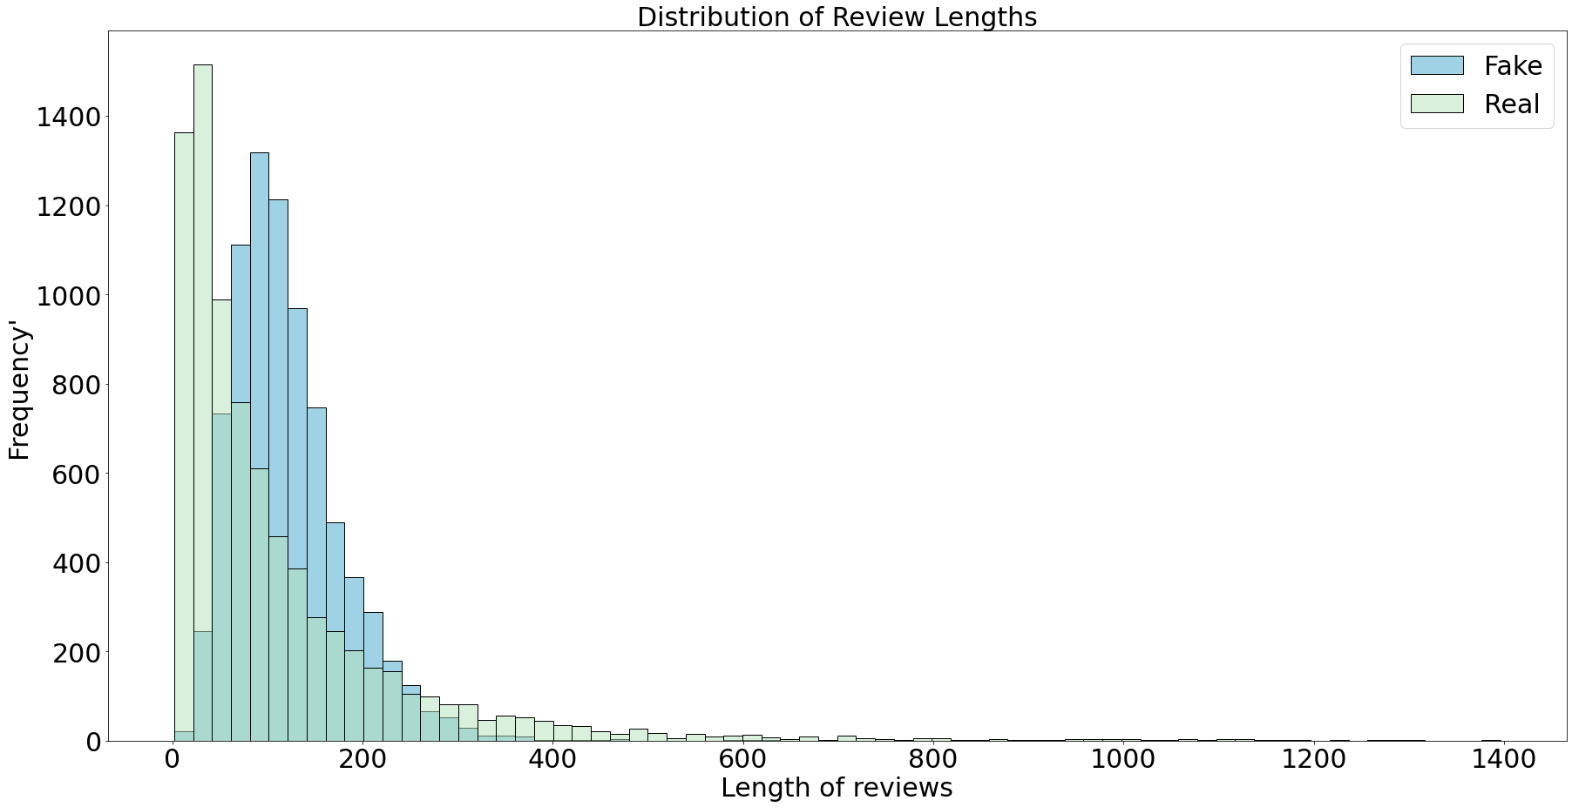
Length of Reviews
The review body length is longer in fake reviews (X̅=121.18) than in real ones (X̅=111.83).
35.1% of real reviews’ review length is 40 or less.
The 3.15% of fake reviews’ lengths are 40 or less.
Fake reviews may be written longer to be more convincing, but in real life, reviews are shorter.

Slide 12
Pre-Processing
Convert into lowercase
Removed items:
Punctuation,
HTML,
Emoji,
URL,
White spaces,
Text in the square brackets, and numbers
Stop words were removed
Tokenization
Stemming
TF-IDF vectorizer
Cosine similarity
94.2% of review text,
98.7% of app descriptions were written in English.
Train-test split
Encoding
Imputing NaNs
Meta Features
Convert into Vectors
Translation
Language Detection
Text Cleaning
Similarity between text and description
Final Checks before Modelling
Generate new features from text
# Punctuation,
# Words
# Average length of words etc.
Non-English reviews and descriptions were translated into English.
GloVe: Word vector representation method
Sentence-BERT: Context of a word in a sentence

Slide 13
Models
Reviews (Bert) + Description (Bert) + All features
Naive Bayes
Multinomial Naive Bayes
Logistic Regression
Decision Tree
0.739
0.890
0.862
0.965
0.983
0.980
Random Forest
0.985
0.980
AdaBoost Classifier
Gradient Boosting
XGBoost Classifier

Slide 14
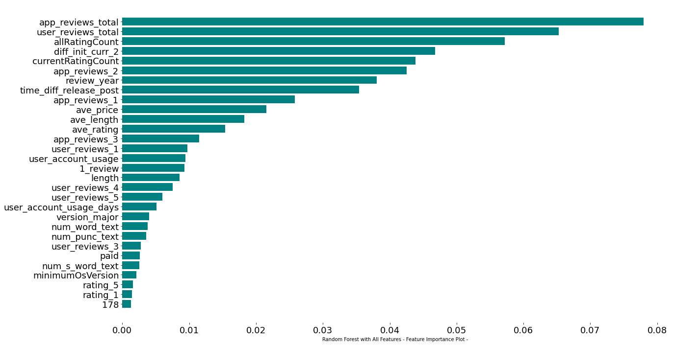
Feature Importances

Slide 15
Models
Reviews (Bert)
Naive Bayes
Multinomial Naive Bayes
Logistic Regression
Decision Tree
0.743
0.732
0.824
0.683
0.786
0.774
Random Forest
0.813
0.799
AdaBoost Classifier
Gradient Boosting
XGBoost Classifier

Slide 16
Features related to users, reviews, and apps play a significant role in detecting fake reviews.
Models with just review text gave worse metrics than models with all features.
As expected, BERT works better than GloVe.
Assuming we do not have any data about reviews, users, and apps, we have just reviews.
Optimize models with review text (BERT).

Slide 17
Hypermeter Optimization
Model | Optimization Type | Mean AUC | Performance on Unseen Test
Logistic Regression | Grid Search | .901 | .824
XGBoost Classifier | Random Search | .884 | .811
Gradient Boosting |  | .879 | 0.811
Random Forest |  | .858 | .784

Slide 18
Conclusion
XGBoost classifier identifies fake reviews with an AUC/ROC value of 98%.
Information about users, applications, and reviews should be considered in fake review detection.
Factors such as the business problem, the aim of the model, and text type should be considered when deciding which vectorization method to use.

Slide 19
For questions, suggestions and feedback
Contact info:
handegulbagci@gmail.com
https://github.com/hangulde

